Slide 1
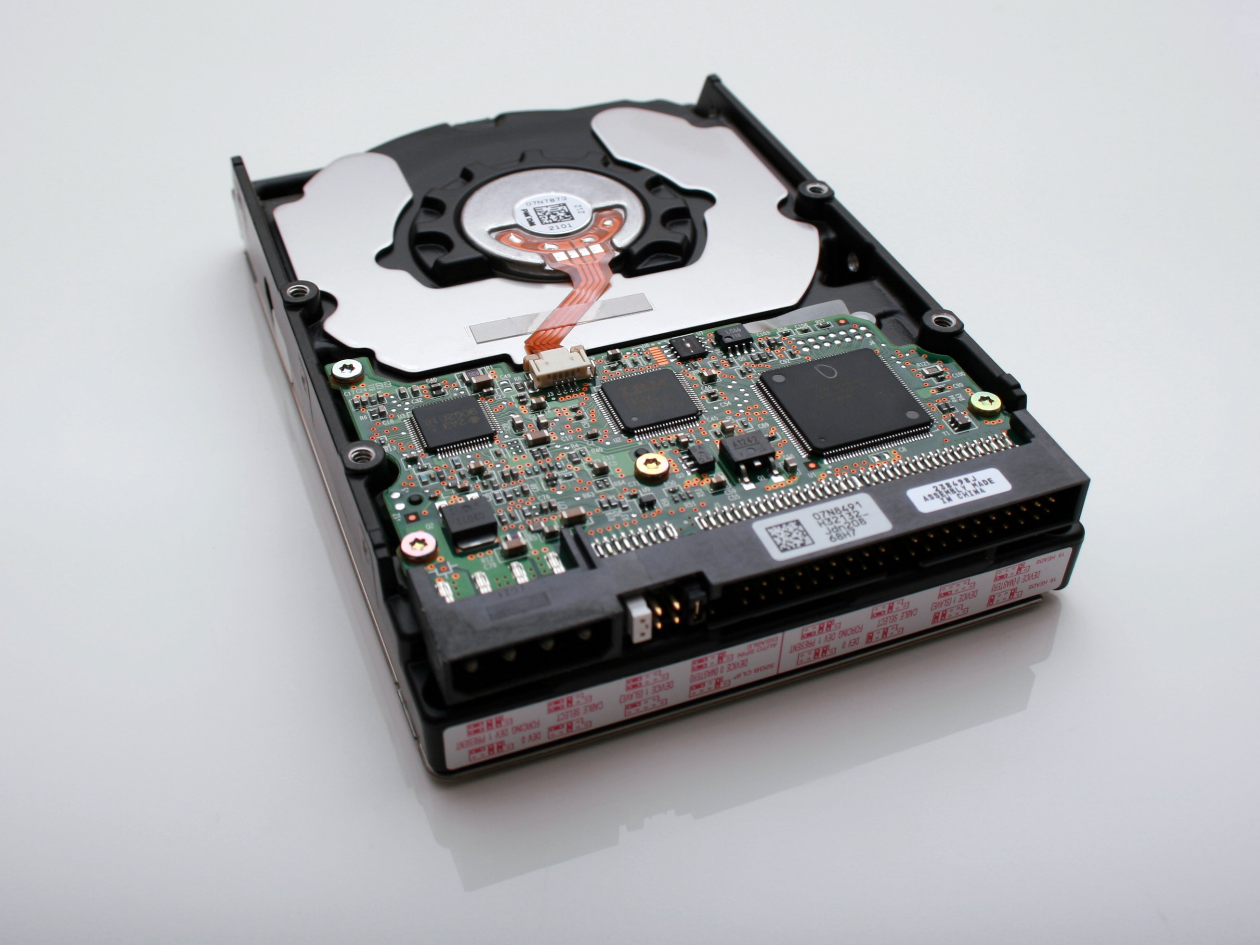
Understanding Kubernetes Storage
Mateusz Dymiński

Slide 2
whoami
Mateusz Dymiński
Software Developer at Nokia
5+ exp with Java
5+ exp with Go
One of the organizer GoWroc - Golang Wroclaw Meetup
Github: github.com/mateuszdyminski
Twitter: @m_dyminski
LinkedIn: linkedin.com/in/mdyminski

Slide 3
Agenda
Challenges in Stateful Containers
Volume Plugins
Stateful Applications
Storage Features
MythBusters
Summary

Slide 4

github.com/mateuszdyminski/storage

Slide 5
Database in Pod
apiVersion: apps/v1
kind: Pod
metadata:
name: mysql
spec:
containers:
- image: mysql:5.6
name: mysql
env:
- name: MYSQL_ROOT_PASSWORD
value: password
ports:
- containerPort: 3306
name: mysql
What happen with data
when container ends?
All the data is lost

Slide 6
Problems with stateful containers
Containers are ephemeral by design
Container termination/crashes result in loss of data
Containers can’t share data between each other.
Can’t run stateful applications
Unless the storage is provisioned and attached to container by Volume Plugin

Slide 7
Volume Plugin
A way to reference block device or mounted filesystem
Ordered Volume is accessible by all containers in pod
Volume plugin specifies
How volume is setup in pod
Where the data resides
Lifetime of volume could be longer than lifetime of pod

Slide 8
Kubernetes Storage - options
File Storage
NFS, SMB, etc.
Block Storage
GCE PD, AWS EBS, iSCSI, Fibre Channel, etc.
File on Block Storage
Data Path Standarized – Posix, SCSI

Slide 9
Kubernetes Volumes Plugins
Remote Storage
GCE Persistent Disk
AWS Elastic Block Store
Azure File Storage
Azure Data Disk
Dell EMC ScaleIO
iSCSI
Flocker
NFS
vSphere
GlusterFS
Ceph File and RBD
Cinder
Quobyte Volume
FibreChannel
VMware Photon PD
Ephemeral Storage
EmptyDir
Expose Kubernetes API
Secret
ConfigMap
DownwardAPI
Local Persistent Volume
Out-of-Tree
Flex (exec a binary)
CSI
Host path

Slide 10

Ephemeral Storage

Slide 11
Ephemeral Storage
File space from host
Temporary!
Data exists only for lifecycle of pod.
Can only be referenced “in-line” in pod definition not via PV/PVC.
Volume Plugin: EmptyDir

Slide 12
Ephemeral Storage - EmptyDir
apiVersion: apps/v1
kind: Pod
metadata:
name: mysql
spec:
containers:
- image: mysql:5.6
name: mysql
env:
- name: MYSQL_ROOT_PASSWORD
value: password
ports:
- containerPort: 3306
name: mysql
volumeMounts:
- name: data
mountPath: /var/lib/mysql
volumes:
- name: data
emptyDir: {}

Slide 13
Ephemeral Storage
Built on top of EmptyDir:
Secret Volume
ConfigMap Volume
DownwardAPI Volume
Populate Kubernetes API as files in to an EmptyDir

Slide 14
Ephemeral Storage – ConfigMap
apiVersion: apps/v1
kind: Pod
metadata:
name: mysql
spec:
containers:
- image: mysql:5.6
name: mysql
env:
- name: MYSQL_ROOT_PASSWORD
value: password
ports:
- containerPort: 3306
name: mysql
volumeMounts:
- name: config-map
mountPath: /etc/mysql.conf
volumes:
- name: config-map
configMap:
name: mysql

Slide 15
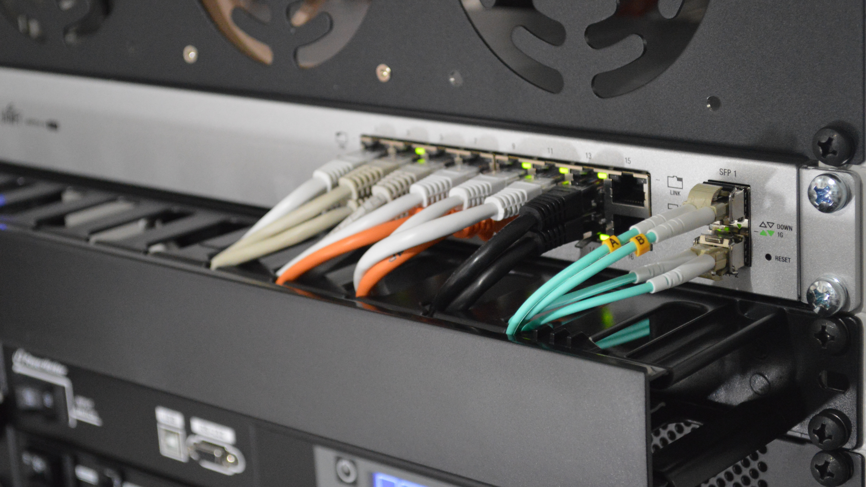
Remote Storage

Slide 16
Remote Storage – EBS example
apiVersion: apps/v1
kind: Pod
metadata:
name: mysql
spec:
containers:
- image: mysql:5.6
name: mysql
env:
- name: MYSQL_ROOT_PASSWORD
value: password
volumeMounts:
- mountPath: /var/lib/mysql
name: ebs-volume
volumes:
- name: ebs-volume
awsElasticBlockStore:
volumeID: <volume-id>
fsType: ext4
There are some restrictions when using an awsElasticBlockStore volume:
the nodes on which Pods are running must be AWS EC2 instances
those instances need to be in the same region and availability-zone as the EBS volume
EBS only supports a single EC2 instance mounting a volume
Pod yaml is no longer portable across clusters!!

Slide 17
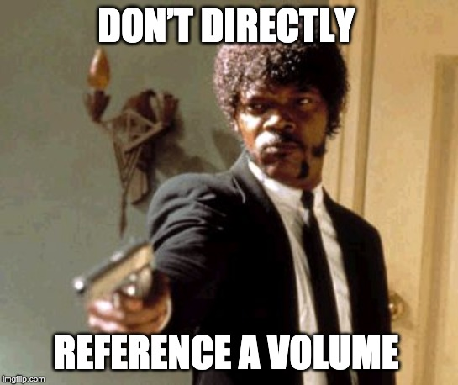

Slide 18


Persistent Volume Persistent Volume Claim

Slide 19
Persistent Volume Persistent Volume Claim
Abstracts and Decouples storage implementation from storage consumption

Slide 20
Pod mounts PersistentVolumeClaim into container(s)
apiVersion: apps/v1
kind: Pod
metadata:
name: mysql
spec:
containers:
- image: mysql:5.6
name: mysql
env:
- name: MYSQL_ROOT_PASSWORD
value: password
volumeMounts:
- name: mysql-persistent-storage
mountPath: /var/lib/mysql
volumes:
- name: mysql-persistent-storage
persistentVolumeClaim:
claimName: mysql-pv-claim
Pod yaml is portable again!!

Slide 21
PersistentVolumeClaim = request for storage
kind: PersistentVolumeClaim
apiVersion: v1
metadata:
name: mysql-pv-claim
spec:
resources:
requests:
storage: 1Gi
accessModes:
- ReadWriteOnce
"Give me 1 GiB of storage."
"That is mountable to single pod as read/write."
"And I don't really care about the rest."

Slide 22
PersistentVolumeClaim (PVC)
Application request for storage.
Created by user / devops.
Binds to single PV.
Usable in Pods.

Slide 23
PersistentVolume
kind: PersistentVolume
apiVersion: v1
metadata:
name: task-pv-volume
labels:
type: local
spec:
capacity:
storage: 10Gi
accessModes:
- ReadWriteMany
- ReadWriteOnce
- ReadOnlyMany
persistentVolumeReclaimPolicy: Retain
awsElasticBlockStore:
fsType: "ext4"
volumeID: "vol-f37a03aa"

Slide 24
PersistentVolume
kind: PersistentVolume
apiVersion: v1
metadata:
name: task-pv-volume
labels:
type: local
spec:
capacity:
storage: 10Gi
accessModes:
- ReadWriteMany
- ReadWriteOnce
- ReadOnlyMany
persistentVolumeReclaimPolicy: Retain
awsElasticBlockStore:
fsType: "ext4"
volumeID: "vol-f37a03aa"
Size of the Volume

Slide 25
PersistentVolume
kind: PersistentVolume
apiVersion: v1
metadata:
name: task-pv-volume
labels:
type: local
spec:
capacity:
storage: 10Gi
accessModes:
- ReadWriteMany
- ReadWriteOnce
- ReadOnlyMany
persistentVolumeReclaimPolicy: Retain
awsElasticBlockStore:
fsType: "ext4"
volumeID: "vol-f37a03aa"
Access modes that the
volume supports

Slide 26
PersistentVolume
kind: PersistentVolume
apiVersion: v1
metadata:
name: task-pv-volume
labels:
type: local
spec:
capacity:
storage: 10Gi
accessModes:
- ReadWriteMany
- ReadWriteOnce
- ReadOnlyMany
persistentVolumeReclaimPolicy: Retain
awsElasticBlockStore:
fsType: "ext4"
volumeID: "vol-f37a03aa"
What to do when the volume is
not needed any longer. Options:
Recycle (deprecated),
Retain,
Delete

Slide 27
PersistentVolume
kind: PersistentVolume
apiVersion: v1
metadata:
name: task-pv-volume
labels:
type: local
spec:
storageClassName: cheap
capacity:
storage: 10Gi
accessModes:
- ReadWriteMany
- ReadWriteOnce
- ReadOnlyMany
persistentVolumeReclaimPolicy: Retain
awsElasticBlockStore:
fsType: "ext4"
volumeID: "vol-f37a03aa"
Pointer to Storage
AWS EBS, Azure DD, Ceph FS & RBD, CSI, FC, Flex, GCE PD, Gluster, iSCSI, NFS, OpenStack Cinder,
Photon, Quobyte, StorageOS, vSphere

Slide 28
PV and PVC step by step
$ kubectl create -f pv.yaml
persistentvolum/task-pv-volume created

Slide 29
PV and PVC step by step
$ kubectl create -f pv.yaml
persistentvolum/task-pv-volume created
$ kubectl get pv
NAME CAPACITY ACCESSMODES STATUS CLAIM REASON AGE
task-pv-volume 10Gi RWO Available 1m

Slide 30
PV and PVC step by step
$ kubectl create -f pv.yaml
persistentvolum/task-pv-volume created
$ kubectl get pv
NAME CAPACITY ACCESSMODES STATUS CLAIM REASON AGE
task-pv-volume 10Gi RWO Available 1m
$ kubectl create -f pvc.yaml
persistentvolumeclaim/mysql-pv-claim created

Slide 31
PV and PVC step by step
$ kubectl create -f pv.yaml
persistentvolum/task-pv-volume created
$ kubectl get pv
NAME CAPACITY ACCESSMODES STATUS CLAIM REASON AGE
task-pv-volume 10Gi RWO Available 1m
$ kubectl create -f pvc.yaml
persistentvolumeclaim/mysql-pv-claim created
$ kubectl get pvc
NAME STATUS VOLUME CAPACITY ACCESSMODES STORAGECLASS AGE
my-mysql-claim Bound pvc-6428 10Gi RWO standard 1m

Slide 32
PV and PVC step by step
$ kubectl create -f pv.yaml
persistentvolum/task-pv-volume created
$ kubectl get pv
NAME CAPACITY ACCESSMODES STATUS CLAIM REASON AGE
task-pv-volume 10Gi RWO Available 1m
$ kubectl create -f pvc.yaml
persistentvolumeclaim/mysql-pv-claim created
$ kubectl get pvc
NAME STATUS VOLUME CAPACITY ACCESSMODES STORAGECLASS AGE
my-mysql-claim Bound pvc-6428 10Gi RWO standard 1m
$ kubectl get pv
NAME CAPACITY ACCESSMODES STATUS CLAIM REASON AGE
task-pv-volume 10Gi RWO Bound mysql-pv-claim 1m

Slide 33
Dynamic provisioning
Cluster admin pre-provisioning PVs is painful and wasteful.
Dynamic provisioning creates new volumes on-demand (when requested by user).
Eliminates need for cluster administrators to pre-provision storage.

Slide 34
Dynamic provisioning
Dynamic provisioning “enabled” by creating StorageClass.
StorageClass defines the parameters used during creation.
StorageClass parameters opaque to Kubernetes so storage providers can expose any number of custom parameters for the cluster admin to use.

Slide 35
StorageClass
kind: StorageClass
apiVersion: storage.k8s.io/v1
metadata:
name: slow
provisioner: kubernetes.io/gce-pd
annotations:
storageclass.kubernetes.io/is-default-class: "true"
parameters:
type: pd-standard
zone: us-east1-d
Collection of PersistentVolumes with the same characteristics.
Usually admin territory.
Global, not namespaced.

Slide 36
StorageClass
kind: StorageClass
apiVersion: storage.k8s.io/v1
metadata:
name: slow
provisioner: kubernetes.io/gce-pd
annotations:
storageclass.kubernetes.io/is-default-class: "true"
parameters:
type: pd-standard
zone: us-east1-d
Who dynamically provisions volumes.
Name of hardcoded volume plugin.
Name of external provisioner.
Name of CSI driver.

Slide 37
StorageClass
kind: StorageClass
apiVersion: storage.k8s.io/v1
metadata:
name: slow
provisioner: kubernetes.io/gce-pd
annotations:
storageclass.kubernetes.io/is-default-class: "true"
parameters:
type: pd-standard
zone: us-east1-d
Parameters for dynamic provisioning.
Depend on the provisioner.

Slide 38
StorageClass
kind: StorageClass
apiVersion: storage.k8s.io/v1
metadata:
name: slow
provisioner: kubernetes.io/gce-pd
annotations:
storageclass.kubernetes.io/is-default-class: "true"
parameters:
type: pd-standard
zone: us-east1-d
One StorageClass in the cluster can be default.
PVC without any StorageClass gets the default one.

Slide 39
Dynamic Provisioning Step by Step

Slide 40
Dynamic Provisioning – mysql yaml
apiVersion: apps/v1
kind: Pod
metadata:
name: mysql
spec:
containers:
- image: mysql:5.6
name: mysql
env:
- name: MYSQL_ROOT_PASSWORD
value: password
volumeMounts:
- name: mysql-persistent-storage
mountPath: /var/lib/mysql
volumes:
- name: mysql-persistent-storage
persistentVolumeClaim:
claimName: mysql-pv-claim
We don’t need to touch Pod Yaml

Slide 41
Dynamic Provisioning – PVC yaml
kind: PersistentVolumeClaim
apiVersion: v1
metadata:
name: mysql-pv-claim
spec:
resources:
requests:
storage: 1Gi
accessModes:
- ReadWriteOnce
storageClassName: slow
We need to add storageClassName

Slide 42
Dynamic Provisioning - step by step
$ kubectl create -f storage_class.yaml
storageclass „slow” created

Slide 43
Dynamic Provisioning - step by step
$ kubectl create -f storage_class.yaml
storageclass „slow” created
$ kubectl create -f pvc.yaml
persistentvolumeclaim/mysql-pv-claim created

Slide 44
Dynamic Provisioning - step by step
$ kubectl create -f storage_class.yaml
storageclass „slow” created
$ kubectl create -f pvc.yaml
persistentvolumeclaim/mysql-pv-claim created
$ kubectl get pvc
NAME STATUS VOLUME CAPACITY ACCESSMODES STORAGECLASS AGE
my-mysql-claim Bound pvc-6428 10Gi RWO standard 1m

Slide 45
Dynamic Provisioning - step by step
$ kubectl create -f storage_class.yaml
storageclass „slow” created
$ kubectl create -f pvc.yaml
persistentvolumeclaim/mysql-pv-claim created
$ kubectl get pvc
NAME STATUS VOLUME CAPACITY ACCESSMODES STORAGECLASS AGE
my-mysql-claim Bound pvc-6428 10Gi RWO standard 1m
$ kubectl get pv
NAME CAPACITY ACCESSMODES STATUS CLAIM REASON AGE
task-pv-volume 10Gi RWO Bound mysql-pv-claim 1m

Slide 46
PV and PVC release
$ kubectl delete pvc mysql-pv-claim
persistentvolumeclaim „mysql-pv-claim” deleted

Slide 47
PersistentVolume – Release
PVC is deleted: persistentVolumeReclaimPolicy is executed:
Recycle (deprecated):
All data from the volume are removed ("rm -rf *").
PV is Available for new PVCs.
Delete:
Volume is deleted in the storage backend.
PV is deleted.
Usually for dynamically-provisioned volumes
Retain:
PV is kept Released.
No PVC can bind to it.
Admin should manually prune Released volumes. In all cases, user can't access the data!

Slide 48
Stateful applications

Slide 49
Deployment
Runs X replicas of a single Pod template.
When a pod is deleted, Deployment automatically creates a new one.
Scalable up & down.
All pods share the same PVC!

Slide 50
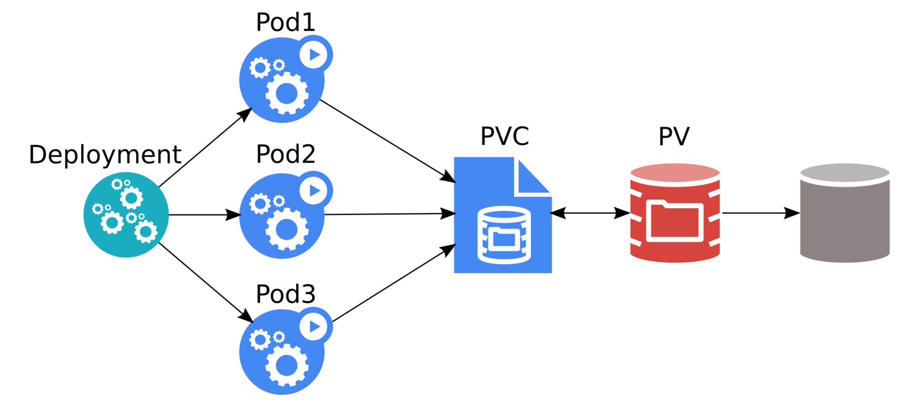
Deployment
Source: Kubernetes Storage 101 - Jan Šafránek, Red Hat & David Zhu, Google

Slide 51
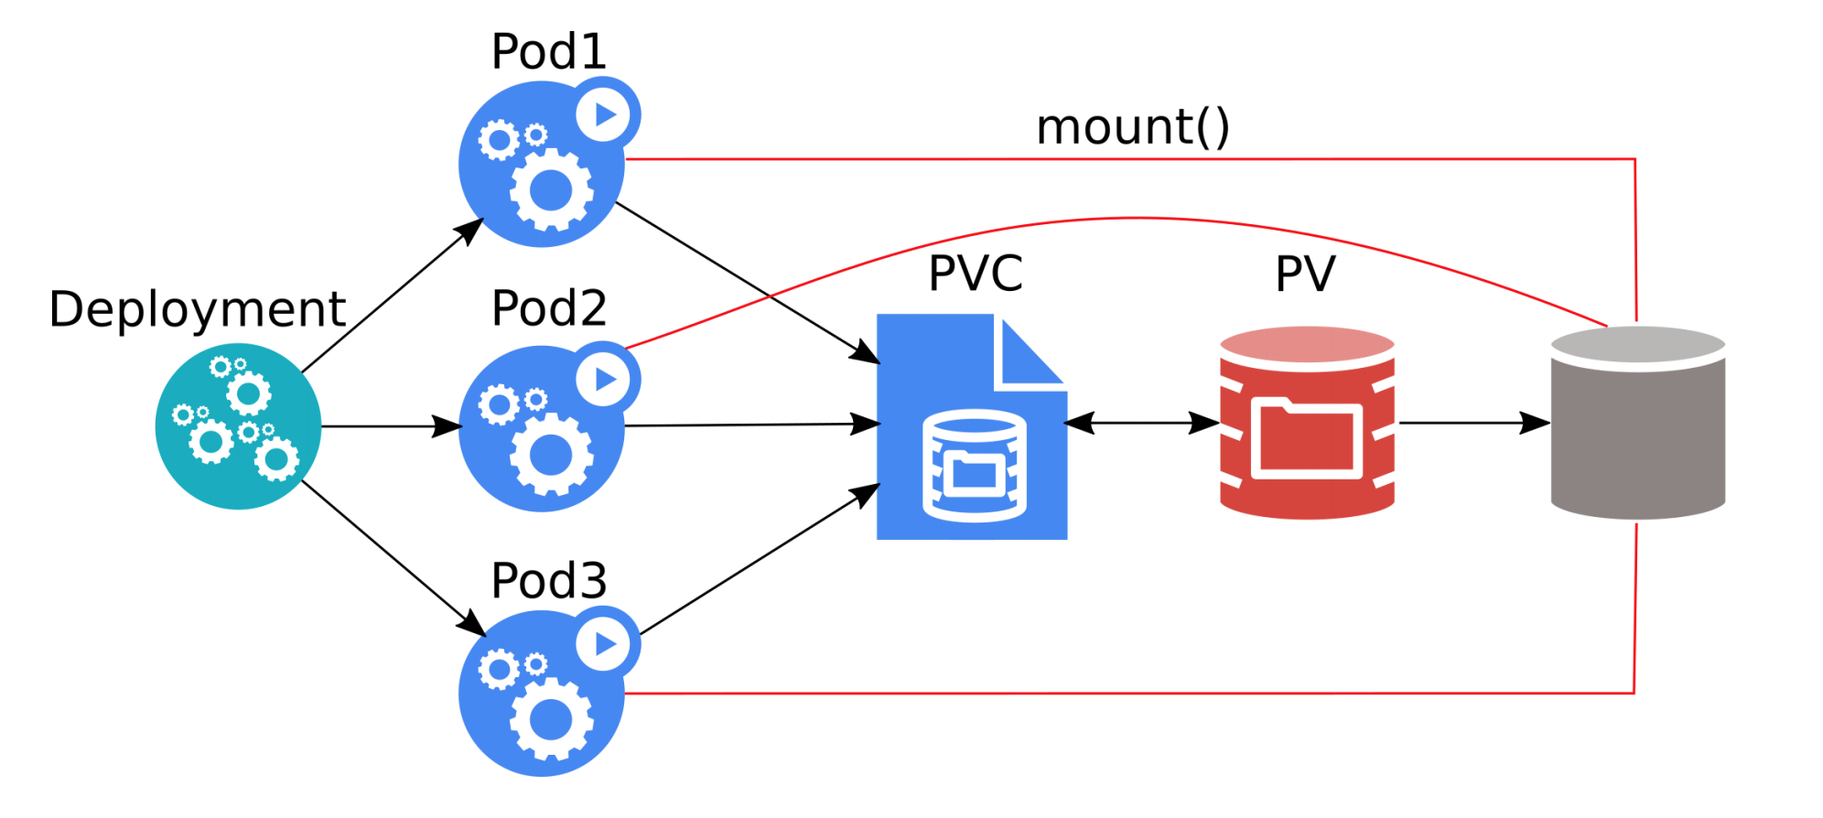
Deployment
All three pods can overwrite data of each other!
Most applications crash / refuse to work.
Source: Kubernetes Storage 101 - Jan Šafránek, Red Hat & David Zhu, Google

Slide 52
StatefulSet
Runs X replicas of a single Pod template.
Each pod gets its own PVC(s) from a PVC template.
When a pod is deleted, StatefulSet automatically creates a new one.
Each pod has a stable identity.
Scalable up & down.

Slide 53
StatefulSet vs Deployment
apiVersion: apps/v1
kind: StatefulSet
metadata:
name: mysql
spec:
selector:
matchLabels:
app: mysql
serviceName: "mysql"
replicas: 3
template:
metadata:
labels:
app: mysql
spec:
containers:
- name: mysql
image: mysql:5.6
volumeMounts:
- name: mysql-persistent-storage
mountPath: /var/lib/mysql
volumeClaimTemplates:
- metadata:
name: mysql-persistent-storage
spec:
accessModes: [ "ReadWriteOnce" ]
storageClassName: "slow"
resources:
requests:
storage: 1Gi
apiVersion: apps/v1
kind: Pod
metadata:
name: mysql
spec:
containers:
- image: mysql:5.6
name: mysql
env:
- name: MYSQL_ROOT_PASSWORD
value: password
volumeMounts:
- name: mysql-persistent-storage
mountPath: /var/lib/mysql
volumes:
- name: mysql-persistent-storage
persistentVolumeClaim:
claimName: mysql-pv-claim

Slide 54
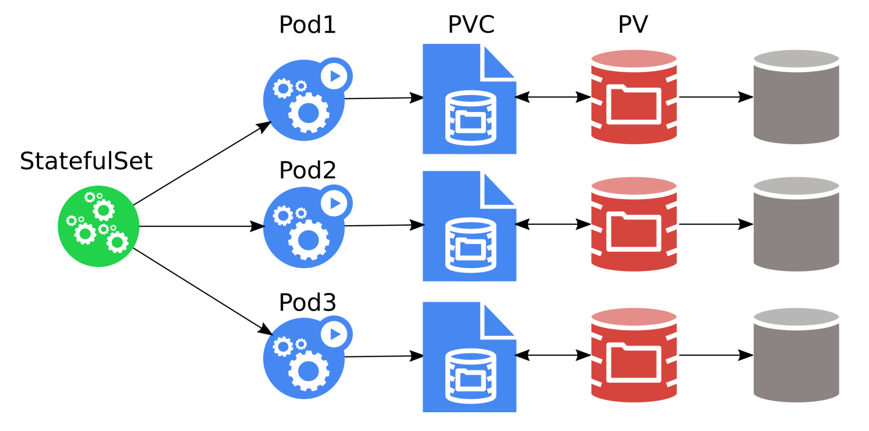
StatefulSet
The pods must be aware of the other StatefulSet members!
Source: Kubernetes Storage 101 - Jan Šafránek, Red Hat & David Zhu, Google

Slide 55
Kubernetes Volumes Plugins
Remote Storage
GCE Persistent Disk
AWS Elastic Block Store
Azure File Storage
Azure Data Disk
Dell EMC ScaleIO
iSCSI
Flocker
NFS
vSphere
GlusterFS
Ceph File and RBD
Cinder
Quobyte Volume
FibreChannel
VMware Photon PD
Ephemeral Storage
EmptyDir
Expose Kubernetes API
Secret
ConfigMap
DownwardAPI
Local Persistent Volume
Out-of-Tree
Flex (exec a binary)
CSI
Host path

Slide 56
Local Volumes
Local disks can be used as PVs.
Expose a local block or file as a PersistentVolume
Reduced durability
Extra speed
Useful for building distributed storage systems
Useful for high performance caching
Kubernetes takes care of data gravity
Referenced via PV/”PVC so workload portability is maintained

Slide 57


Slide 58
CSI = Container Storage Interface
Container Storage Interface (CSI) is an initiative to unify the storage interface of Container Orchestrator Systems (COs) like Kubernetes, Mesos, Docker swarm, cloud foundry, etc.
Implementing a single CSI for a storage vendor is guaranteed to work with all COs.

Slide 59
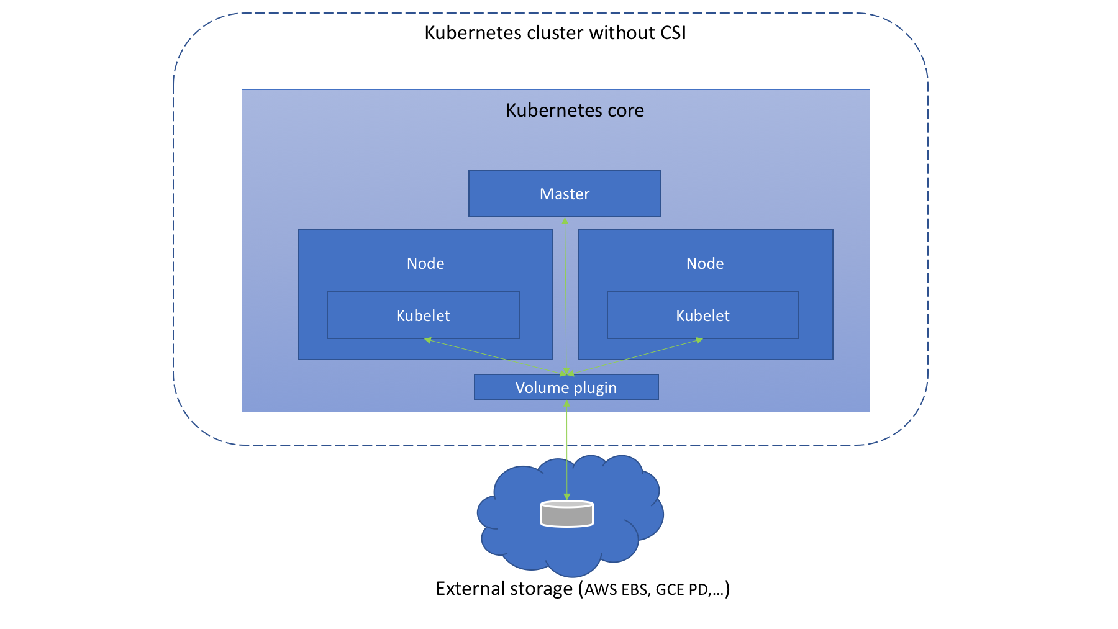
Before CSI
Source: https://medium.com/google-cloud/understanding-the-container-storage-interface-csi-ddbeb966a3b

Slide 60
Before CSI - problems
Volume plugin development coupled and dependent on Kubernetes releases.
Kubernetes developers/community are responsible for testing and maintaining all volume plugins.
Bugs in volume plugins can crash Kubernetes core components
Volume plugins get full privileges of kubernetes components (kubelet and kube-controller-manager).
Plugin developers are forced to make plugin source code available – open-source

Slide 61
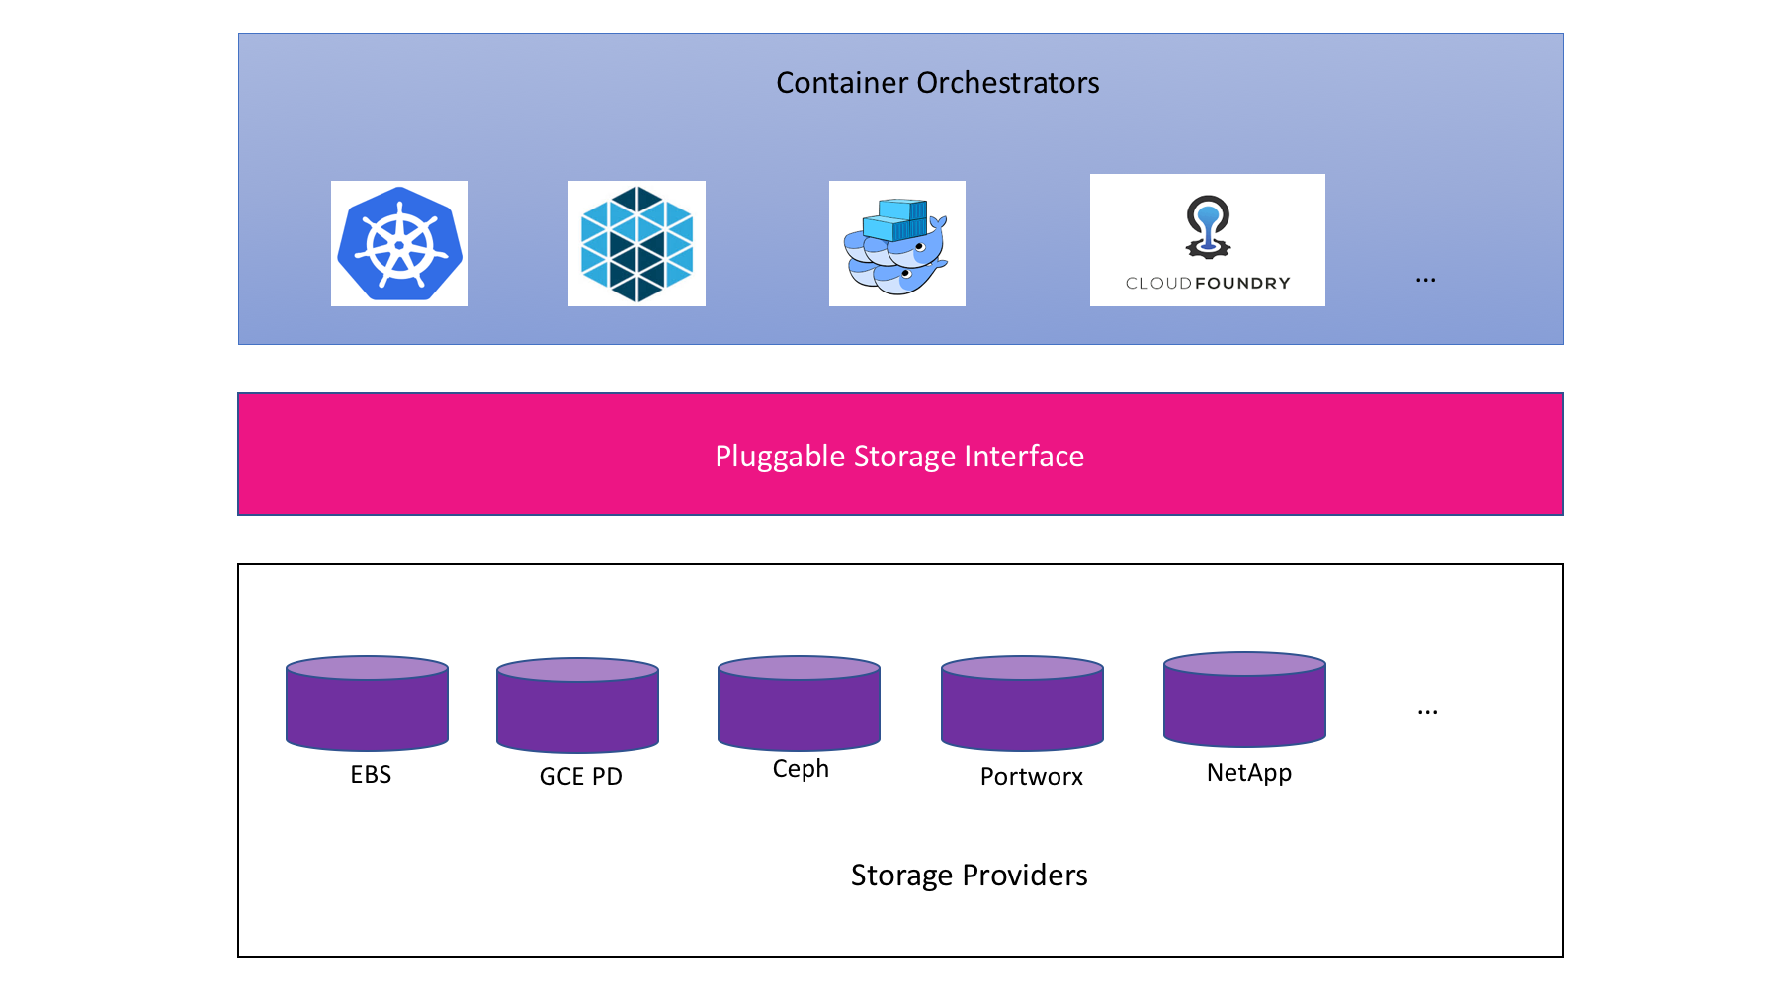
CSI concept
Source: CloudNativeCon EU 2018 CSI Jie Yu

Slide 62
CSI exmaple
kind: StorageClass
apiVersion: storage.k8s.io/v1
metadata:
name: fast-storage
provisioner: csi-driver.example.com
parameters:
type: pd-ssd
csi.storage.k8s.io/provisioner-secret-name: mysecret
csi.storage.k8s.io/provisioner-secret-namespace: mynamespace

Slide 63
CSI – materials
Webpage - https://kubernetes-csi.github.io/
Specification - https://github.com/container-storage-interface/spec
Great talks:
Container Storage Interface: Present and Future - Jie Yu
Container Storage Interface for Kubernetes

Slide 64

Storage features

Slide 65
Resize of PV
Only expansion is supported.
Offline.
Online (alpha).

Slide 66
Snapshots
Part of CSI.
Can take a snapshot of PVC.
PVC can be provisioned from a snapshot.
VolumeSnapshotContent, VolumeSnapshot, VolumeSnapshotClass CRDs are intruduced
More: https://kubernetes.io/blog/2018/10/09/introducing-volume-snapshot-alpha-for-kubernetes/

Slide 67


Slide 68
Myth 1: Applications in containers must be stateless
Unless persistent volume is used
Statistic shows that 40% of workloads are stateful
It’s myth

Slide 69
Myth 2: Writes done by container apps are slow
hostPath and Local Volumes are almost as fast as bare metal
Perf depends on remote storage
Perf depends on cloud provider
You need to test it by your own
Tools:
Sysbench
Pg_bench
Recommended to watch
Benchmarking Cloud Native Storage - Josh Berkus, Red Hat – KubeCon Europe 2019 - https://www.youtube.com/watch?v=4V-4yPSfN3U
It’s not myth

Slide 70
Myth 3: Storing data on k8s requires remote distributed storage
It’s myth
We have an options:
Persistent Local Volume
Host Path – don’t use it unless you know what you are doing

Slide 71
Myth 4: Never run DB on k8s
It’s myth
But:
DB as a service >>>> DB in K8s

Slide 72

Summary

Slide 73
Takeaways
Storage on K8s is not that complicated as many think
Persistent Local Volume is ‘almost’ as fast as bare metal storage
Don’t use direct references of volumes in your Pod
Use dynamic provisioning
Still DB as a service is better (not cheaper) than DB on K8s

Slide 74

Q&A

